Slide 1
WHAT IS BIG DATA

Slide 2
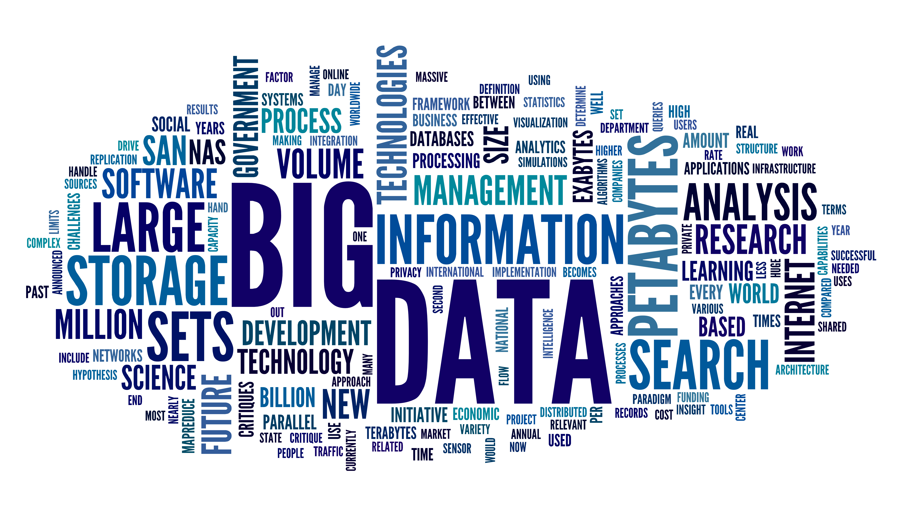

Slide 3
WHERE IS BIG DATA GOING TO RESIDE

Slide 4



Slide 5
WHERE IS MY DATA?

Slide 6
WHERE IS THE DATA ORIGINATING FROM?

Slide 7
IS MY DATA SECURE

Slide 8
WHO IS ACCESSING MY DATA

Slide 9
IS MY DATA BEING SERVED TO THE RIGHT AUDIENCE?

Slide 11

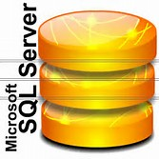
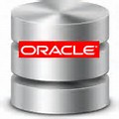
Data Lake Challenge
ERP
Files

Slide 12
Joint Engineering

Slide 13
Disclaimer
This document may contain product features and technology directions that are under development or may be under development in the future.
Technical feasibility, market demand, user feedback, and the Apache Software Foundation community development process can all effect timing and final delivery.
This document’s description of these features and technology directions does not represent a contractual commitment from Hortonworks to deliver these features in any generally available product.
Product features and technology directions are subject to change, and must not be included in contracts, purchase orders, or sales agreements of any kind.

